Slide 1

Rain Prediction System
Sahil Sawant (20104006)
Adarsh Rai (20104039)
Raj Solkar (20104087)
Project Guide
Prof. Mr. Ganesh Gourshete

Slide 2
Contents
Introduction
Objectives
Scope
Literature Survey
Proposed System
Project Outcomes
Block Diagram
Use Case/DFD
Technology Stack
Suggestions in Review-1
Result and Discussion
Conclusion
Reference

Slide 3
1. Introduction
Rainfall prediction remains a serious concern and has attracted the attention
of governments, industries, risk management entities, as well as the scientiﬁc
community. Rainfall is a climatic factor that aﬀects many human activities like agricultural production, construction, power generation, forestry and tourism, among others.
To this extent, rainfall prediction is essential since this variable is the one with the highest correlation with adverse natural events such as landslides, ﬂooding, mass movements and avalanches. These incidents have aﬀected society for years.
Therefore, having an appropriate approach for rainfall prediction makes it possible to take preventive and mitigation measures for
these natural phenomena.

Slide 4
2. Objectives
To provide users with easy access to the techniques and approaches used in the field of precipitation prediction.
To understand & analyze the data collected for rainfall for all the area via linear regression algorithms.
To provide comparative studies between various machine learning techniques.
To provide an interactive and user-friendly UI for user’s ease of understanding the results obtained from the input data provided.

Slide 5
3. Scope
Rainfall Prediction System is significant not only on the micro but also on the macro level.
The Rainfall Prediction System is of significance in the field of agriculture, water reserve management, flood prediction.
It is also important to be utilized by the agricultural industries for keeping their crops safe and ensure the production of seasonal fruits and vegetables by updated rainfall prediction.

Slide 6
4. Literature Survey
Sr.no | Title | Author(s) | Year | Algorithms | Limitations | Result
1 | An Application of Neural Networks for Rainfall Prediction | Kin C. Luk, J.E. Ball and A. Sharma | 2001 | Multiple Regression Techniques were used inside a neural network | It involves very lengthy and complicated procedure of calculations and analysis | Result was accurate and can be used for prediction in future
2 | Computational Analysis of Neural Network Model | A.C. Subhashini and V. Joseph Raj | 2010 | Back propagation algorithm was used in this model | The model is quiet sensitive to noisy data and that’s why there is hinderance in results | Back propagation has proven to be useful in this study
3 | Temperature Forecasting based on Neural Network Approach | Mohsen Hayati and Zahra Mohebi | 2007 | They tested using real time dataset and used back propagation algorithm | The model takes a large time for computation of result. More time is used in this process | Their model had potential to forecast temperature

Slide 7
5. Proposed System
The proposed solution to this is to predict precipitation in short-term forecasts. Designing and developing a precipitation forecasting system with a web interface (GUI).
Predict precipitation of the next day at a particular location. Accurate and accurate forecasts help develop better strategies for agriculture and water storage, and are also informed about floods to implement precautionary measures.
Prediction systems are implemented comparing various machine learning algorithms using linear regression. The data is analysed and visualized using histograms, graphs, etc. to derive meaningful information from the patterns of precipitation data obtained.

Slide 8
6. Algorithm Used
Linear regression is a supervised machine learning algorithm used to predict a continuous outcome variable based on one or more input variables (also known as features). The algorithm works by finding a linear relationship between the input variables and the outcome variable.
In its simplest form, linear regression involves finding the line of best fit through a set of data points. The line of best fit is the one that minimizes the sum of the squared differences between the observed values and the predicted values.

Slide 9
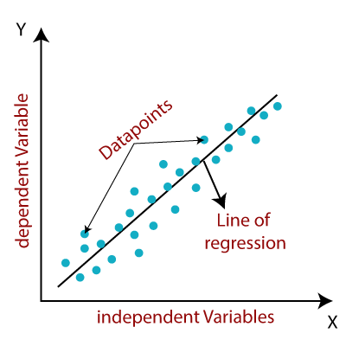
Data Set Used - Rainfall Prediction in Australia dataset from Kaggle

Slide 10
7. Outcome of Project
User will be able to see predictions based of many factor
Can be used for supervised learning and outlier detection.
High prediction accuracy.
User will be able to plan his/her day according to the prediction

Slide 11
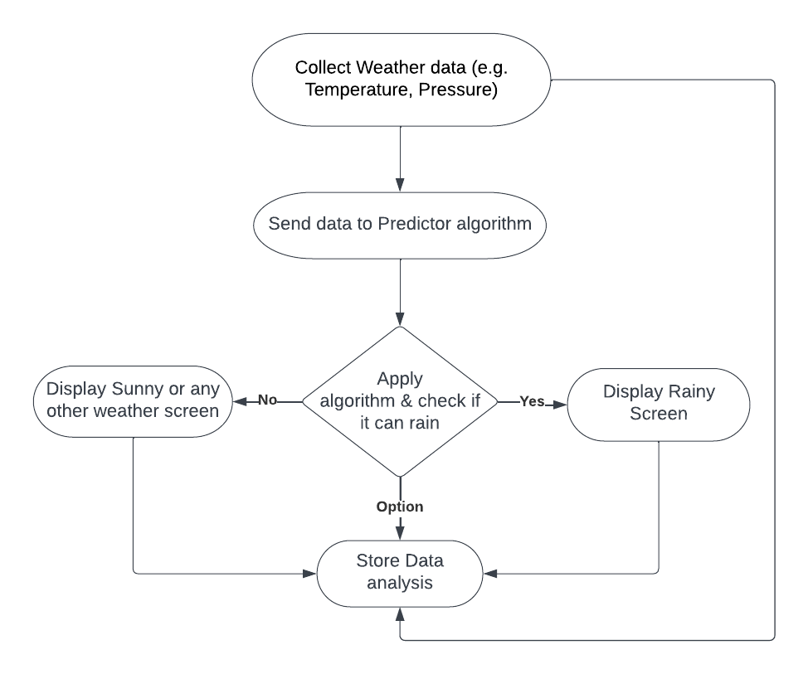
8. Block Diagram

Slide 12
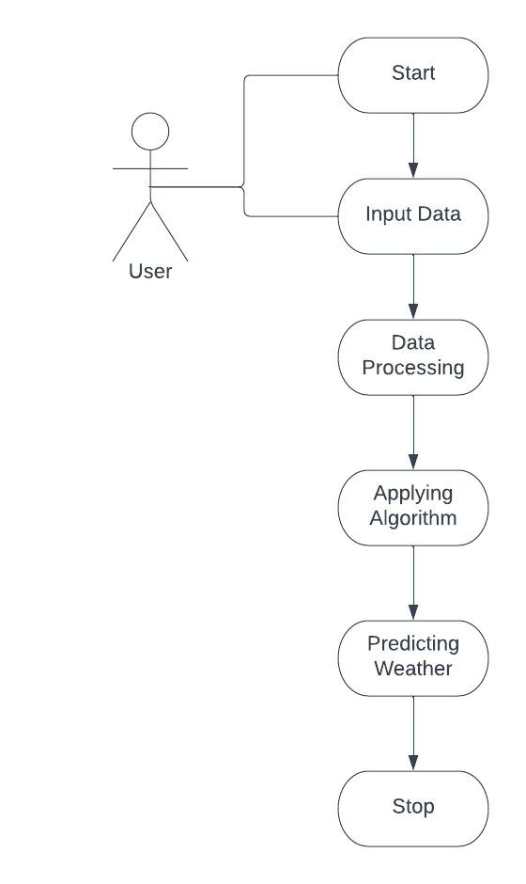
9. Use Case

Slide 13
10. Technology Stack
Front-End: HTML, CSS, Bootstrap, Flask
Back-End: Flask
IDE: Google collab, Pycharm

Slide 14
Suggestions in Review-1
Add to get windgust
Add API for current temperature and humidity

Slide 15
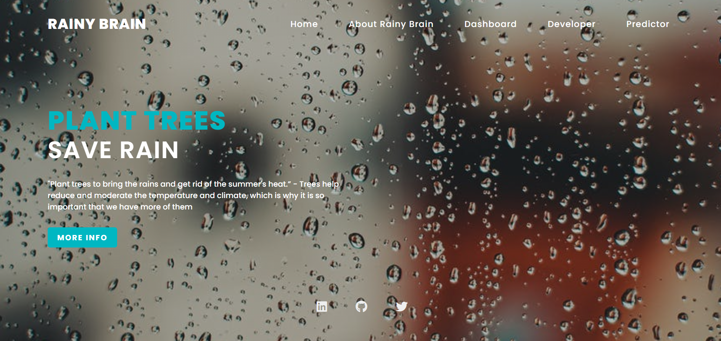
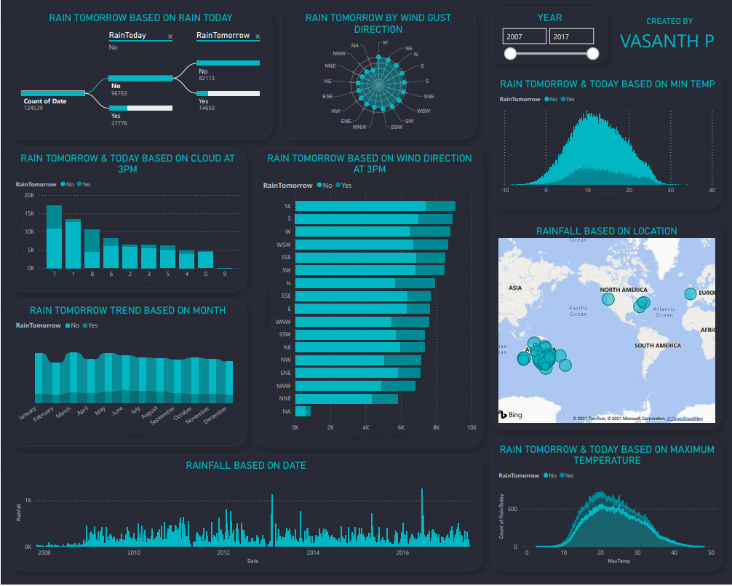
Result and Discussion

Slide 16
Conclusion and Future Scope
Conclusion:
A rain prediction system using machine learning is a powerful tool that can provide accurate and timely information about weather conditions. The system works by analyzing historical weather data and identifying patterns using machine learning algorithms, which can predict future rainfall with a high degree of accuracy.
Future Scope:
As we have a huge amount of data, we can apply Deep Learning models such as Multilayer Perceptron, Convolutional Neural Network, and others. It would be great to perform a comparative study between the Machine learning classiﬁers and Deep learning models.

Slide 17
References
National Oceanic and Atmospheric Administration (NOAA) - This is a US-based government agency that provides weather forecasts and warnings. Their website, https://www.noaa.gov/,
European Centre for Medium-Range Weather Forecasts (ECMWF) - This is an independent organization that provides weather forecasts and predictions for Europe and other parts of the world. Their website, https://www.ecmwf.int/
The Weather Channel - This is a popular weather-related website and app that provides weather forecasts and predictions for various locations around the world. Their website, https://weather.com

Slide 18
Thank You...!!

